Slide 1
Housekeeping
Hilary Fox, IPOLA Project Manager

Slide 2
Housekeeping
The session will be recorded
To ask a question:
Use the Q&A option during the session – can ask anonymously
We will moderate and publish questions – react or vote then becomes available for participants
Moderators will give you an opportunity to ask questions verbally if you raise your hand
Further opportunity to ask questions at the end of the session – please raise your hand and we’ll identify you, and switch on your microphone, or use the Q&A function.

Slide 3
Office of the Information Commissioner, Cyber Security Unit and Clayton Utz
Mandatory Notification of Data Breach scheme
– Templates to support agency compliance
15 May 2025

Slide 4
Today's agenda and speakers
The Information Commissioner
Acknowledgement of Traditional Owners
Introduction to the session
Qld Government Cyber Security Unit
Cyber incidents and data breaches
Clayton Utz
Observations
Principles underpinning development of a policy and response plan
Tips to guide preparation for the scheme
Templates supporting compliance

Slide 5
Acknowledgement of Traditional Owners
We acknowledge the Traditional Owners of the land on which we are meeting today, the Turrbul and Yuggera Peoples. We extend respect to their Elders, past and present, and to First Nations people from across Queensland who join us today.

Slide 6
Introduction to the session
From the
Information Commissioner,
Joanne Kummrow

Slide 7
Cyber incidents and data breaches
Danielle Mahl
Manager - Incident Management, Exercising and Corporate Services
Queensland Government, Cyber Security Unit

Slide 8
Let’s clarify
A cyber incident is an entry point; a data breach is the outcome.
Not all cyber-attacks result in data breaches, but lots do. CSU work in alignment with the OIC.
Cyber security is a subset of information security that addresses a specific risk to digital information.

Slide 9
Experiencing an incident and breach?
CSU can provide beginning to end support (tech or not) for your cyber incident and any resulting data breach.
Alongside CSU resources, reputable and trusted IR partners are on call to aid response efforts.
Reporting is how you access our services – Sooner is always better; we can’t help if we don’t know.

Slide 10
How to report?
Request access now and report via the CSU Incident Reporting Portal: cdc.cyber.qld.gov.au
Submit a Manual Form (form is in the IS:18 incident reporting standard) to CSU Incident Response mailbox: CyberDefenceCentre@cyber.qld.gov.au
Incident Reporting 24/7 Number: 07 3215 3951

Slide 11
Cyber is a Team Sport
CSU are always happy to talk to your organisation about how we can help you prepare or respond:
danielle.mahl@cyber.qld.gov.au (talk to me)
cybersecurityunit@cyber.qld.gov.au (engagement)

Slide 12
Templates supporting the MNDB scheme
Eleanor Dickens, Legal Partner
and
Andreas Ostenfeldt, FTS Director
Clayton Utz

Slide 13
Overview
Initial observations
Key principles in developing a policy and response plan
Tips to guide preparation for the MNDB scheme
Templates supporting the MNDB scheme

Slide 14
1 - Initial observations
Are we there yet?
1 July 2025 has been a long time coming – over 12 months since the sector was aware of the MNDB
With little over 1 month to go – is the sector ready?
Most of the issues for discussion today are not new and have been circulating across the sector for a significant period as we get ready for the MNDB
The seminar today allows for an additional opportunity to discuss steps and actions in preparing for the MNDB
Further, we now have the opportunity to consider this issue in the context of templates that have been prepared to assist agencies on the pathway to compliance
Eligible Data Breach Register Template
Data Breach Policy Template
Data Breach Response Plan Register

Slide 15
1 - Initial observations (cont)
Central themes to discuss today:
Multidisciplinary approaches and teams are necessary – there is no room for silos
People are the key: systems and processes are critical too, but people are the first point of protection and risk
Cultural change is necessary
Knowing and understanding information holdings and complexities in the MNDB scheme is paramount
Not just compliance – but a risk issue which requires organisational change and sophistication in terms of how information and data issues are considered
The sector is already dealing with data breaches and making notifications

Slide 16
2 – Key principles
The key principles in developing a policy and response plan are:
1. | Allow for flexibility
2. | Organisationally aware
3. | Put the right people in the room
4. | Realistic
5. | Easy to read
6. | Reflect multidisciplinary approach

Slide 17
3. Tips for preparation
The countdown to commencement – some key activities/actions
Take time to understand the complexities of the MNDB scheme
Multidisciplinary teams for a multidisciplinary response
An opportunity to build maturity
We have got this!

Slide 18
3.1 – Key countdown activities
Agencies need to develop and continue to develop systems, processes and procedures as critical tools in preparing for and responding to data breaches and the MNDB scheme
This requires an understanding of current systems, processes and procedures:
audit and analysis of information holdings (including if overcollection of personal information occurs)
how systems, processes and procedures interact with others (or can / should it interact with others)
This can be difficult, but is an essential step to preparing and responding to data breaches
To be ready, it will require amendments across the information policy and procedure landscape within an agency and the development of new systems, processes and procedures

Slide 19
3.1 – Key countdown activities (cont)
Some examples:
Privacy policy and procedures
Data Breach Policy
Data Breach Response Plan
Register of Eligible Data Breach
Data Breach Notification Procedure and decision-making documents
Delegations
Risk assessment tools
Communication protocols
Data Breach Response Team or Unit

Slide 20
3.2 - Understand the MNDB scheme
There are many complexities and nuances in the MNDB scheme such as:
assessment process for notifications and relevant exemptions; and
overlays with other frameworks (e.g. Crime and Corruption overlay or critical infrastructure obligations)
Agencies will have to grapple with these complexities often in challenging, time sensitive circumstances which will be difficult without a full appreciation of the MNDB framework
As an example, note the exemptions to notification – these exemptions include a range of threshold legal tests and issues for consideration by the decision-maker

Slide 21
3.3 – Multidisciplinary teams
A multidisciplinary issue that requires multidisciplinary teams to prepare and respond
No room for a siloed approach – not a landscape in which IT, privacy or legal teams can have sole responsibility and/or manage these issues in isolation in terms of preparation and actual response
A 'whole of agency' multidisciplinary response is now needed. This is true whether:
the data breach is due to a 3rd party interaction (e.g. hack); or
the data breach is due to internal interaction (e.g. rogue officer or mistake by employee)
In all instances - you will need to draw expertise across your agency, both in preparing for data breach scenarios, as well as actually responding to one

Slide 22
3.4 - Opportunity to build maturity
Building sophistication is necessary to effectively navigate privacy reforms beyond the MNDB scheme
This will not happen overnight – however, MNDB requirements are a helpful lever to assist in awareness and education, and to embed a culture of best practice with data management.
Move beyond educational and awareness programs
Embed information handling and requirements around information hygiene into roles and responsibilities
Agency wide audit with clear lines of responsibility, reporting and timeframes
Establish accountabilities and requirements around failing to comply, and taking action against infringements
Establish appropriate governance arrangements (including establishing a Risk Committee)
Ultimately privacy will be considered a risk issue as opposed to just a compliance issue

Slide 23
3.5 – We have got this!
Agencies are already dealing with data breach incidents and have systems and processes already in place
there may be some refinement and adaptations necessary to these systems and processes
Agencies have also been making voluntary notifications to the OIC on a routine basis
While the commencement of the IPOLA Act will see the application of a new regulatory scheme across the sector, the concept is not new
the Commonwealth and NSW have mandatory data breach schemes in place
A range of support is available from OIC and the Cyber Security Unit (CSU) to support your pathway of compliance

Slide 24
4 – MNDB templates
A suite of MNDB templates are now available to assist agencies on the pathway to compliance:
Data Breach Policy Template
Data Breach Response Plan Register
Eligible Data Breach Register Template

Slide 25
4 – MNDB templates (cont)
Key stages of the policy and response plan
Prepare
Identify
Assess
Notify
Review and remediate

Slide 26
Questions
For:
Joanne
Danielle
Eleanor or Andreas

Slide 27
And finally

Slide 28
OIC resources to assist and inform
Resource library
73 Guidelines
Other resources such as checklists, and templates including:
Prepare for IPOLA checklist
OIC’s (Draft) Privacy Policy
A suite of MNDB scheme model documents
Data breach assessment tool (to be published shortly)
Training
Staged program to build awareness, knowledge and application
Materials and webinar recordings available
Communication and engagement
OIC IPOLA webpages (transition 1 July 2025)
Newsletters (quarterly and weekly updates)
Direct messaging to 277 Heads of Agencies and subscribers
Engaging through forums, CoPs and workshops
28

Slide 29
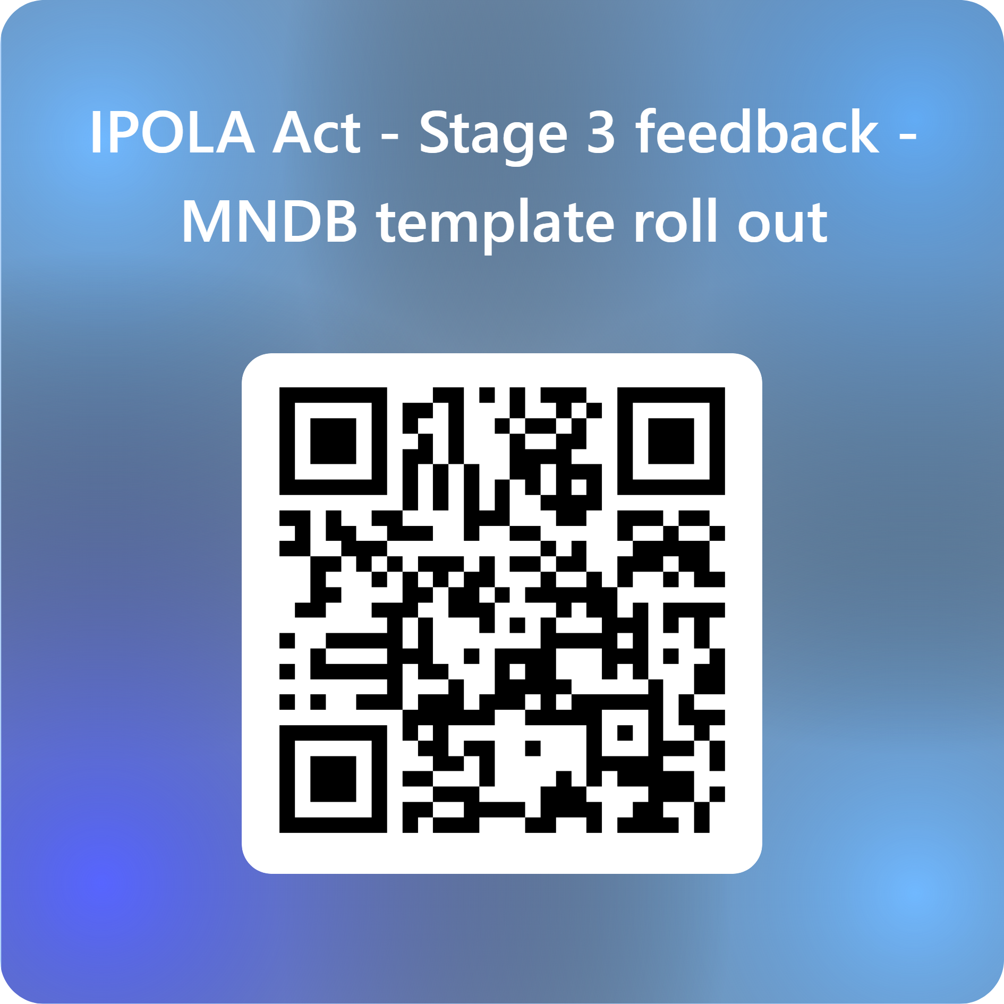
Further information
Ongoing support and advice:
Enquiry Service: 07 3234 737 or 1800 642 753
Email: enquiries@oic.qld.gov.au
Stay connected via LinkedIn or subscribe to our newsletters. Visit OIC.qld.gov.au to subscribe
Feedback:
Link: https://forms.office.com/r/TYqvxA4Way
By QR:
Thank you!

