Slide 1
IPOLA Project: Stage 3 - Right to Information Reviewable decisions and judicial functions

Slide 2
Acknowledgement of Traditional Owners
The Office of the Information Commissioner acknowledges the Traditional Owners of the land on which we are meeting today, the Turrbul and Yuggera Peoples. We extend respect to their Elders, past and present, and to First Nations people from across Queensland who join us today.

Slide 3
Session outline
Reviewable decisions
Judicial function decisions
External review - decisions and appeals

Slide 4
Reviewable decisions
A reviewable decision means a decision mentioned in schedule 4A
Relevance of the ‘reviewable decision’ definition
An ‘affected person’ may apply to have reviewable decision:
reviewed by agency (s.80)
reviewed by Information Commissioner (s.85).
What is a reviewable decision?
From 1 July 2025, a new Sch 4A will list the reviewable decisions
These reviewable decisions can be:
internally reviewed by the agency, or
externally reviewed by the OIC.
Refer to IPOLA Guideline: Review rights under the RTI Act for more information

Slide 5
Reviewable decisions
Schedule 4A decisions will be:
Decisions relating to access applications
Decisions relating to amendment applications

Slide 6
Reviewable decisions
Schedule 4A(1): Reviewable access application decisions:
the application, or part, is out of scope of this Act (s.32(1)(b)), except for a judicial function decision
the application does not comply with all relevant s.33(6) application requirements
a decision to disclose a document:
contrary to the views of a third party obtained under s.37; or
if an agency should have obtained the views of a third party under s.37, but didn’t;
refusing to deal with the application under Chapter 3, Part 4
refusing access to all or part of a document under s.47
Cont …

Slide 7
Reviewable decisions
Schedule 4A(1): Reviewable access application decisions (cont):
deferring access to a document under s.72
giving access to documents subject to the deletion of information under s.73
giving access to documents that purports to give access to all documents applied for, but may not
giving access to documents in a form different than applied for by the applicant, unless such access would involve copyright infringement
whether a processing or access charge is payable to access a document (including a decision not to waive charges)
a deemed decision.

Slide 8
Reviewable decisions
Schedule 4A(1): Reviewable amendment application decisions:
the application, or a part, is out of scope of this Act (s.78J(1)(b)), except a judicial function decision
the application does not comply with all relevant application requirements (s.78K(6))
refusing to deal with the application under Chapter 3A, Part 4
refusing to amend a document (s.78Q)
a s.78V(5) decision that information to which a notice under s.78V(2) relates is not information the applicant was entitled to apply to amend
a deemed decision.

Slide 9
Reviewable decisions
What is a decision that purports to, but may not, cover all documents in scope of the application?
For example, a decision that one document has been located and can be released in full.
Previously, this would not fall within the definition of a ‘reviewable decision’.
What is the implication for agencies?
This is now a reviewable decision and can be the subject of an internal review.

Slide 10
Questions?

Slide 11
Session outline
Reviewable decisions
Judicial function decisions
External review - decisions and appeals

Slide 12
Judicial function decisions
What is a judicial function decision?
Section 32 – application or part of an application falls outside the scope of the RTI Act – the entity is an entity to which the RTI Act does not apply.
Schedule 2, Part 2
a court, or the holder of a judicial or other office connected with a court,
a registry or other office of a court, and their staff acting in their official capacity,
a tribunal performing it judicial or quasi-judicial functions
a tribunal member or office-holder when performing its judicial or quasi-judicial functions
a tribunal registry and staff when performing the tribunal’s judicial or quasi-judicial functions
a quasi-judicial entity in relation to its quasi-judicial functions
a member of, or the holder of an office connected with, a quasi-judicial entity when performing its quasi-judicial functions
the staff of a quasi-judicial entity when performing the entity’s quasi-judicial functions.

Slide 13
Judicial function decisions
What are the implications for agencies?
These types of decision are not a ‘reviewable decision’ and so cannot be the subject of an internal or external review.
These decisions are only reviewable by QCAT, under s119 of the RTI Act.

Slide 14
Deemed decisions
A deemed decision has not changed, however, the circumstances in which a deemed decision occurs has changed.

Slide 15
New s.86A external review during extension to processing period. New s.86B external review during extension to internal review processing period – deemed decision.
The actions of the applicant seeking an external review causes the application to become a deemed decision.
Explained: The application of s.86B (after 1 July 2025):
if the agency is operating on an internal review (s.82A(1)), and
has requested a further specified processing period (s.82A(2)), and
the internal review processing period has ended, and
the further specified period has not ended, and
the agency has not given the applicant a written decision, then
the applicant can apply for an external review, and
the agency is taken to have made a decision affirming the original decision (a deemed decision), and
the agency does not need to notify the applicant of the deemed decision.

Slide 16
Questions?

Slide 17
Session outline
Reviewable decisions
Judicial function decisions
External review - decisions and appeals

Slide 18
External review – decisions and appeals
Section 110(1): After conducting an external review, requires the Information Commissioner to make a written decision, and provide reasons, that:
affirms the decision; or
varies the decision; or
sets aside the decision and makes a substitute decision; or
sets aside the decision, and gives a direction under section 110A or 110B.

Slide 19
Decisions that can be remitted:
Section 110A(5)
that the application or a part of the application is outside the scope of this Act under section 32(1)(b); or
that the application does not comply with all relevant application requirements under section 33(6); or
to refuse to deal with the application under chapter 3, part 4; or
to refuse access to a document under section 47(3)(f) because other access to the document is available; or
to refuse access to a document containing prescribed information by giving written notice under section 55(2).

Slide 20
Decisions that can be remitted:
Section 110B(5)
that the application or a part of the application is outside the scope of this Act under section 78J(1)(b);
that the application does not comply with all relevant application requirements under section 78K(6);
to refuse to deal with the application under chapter 3A, part 4.

Slide 21
What are the relevant considerations when the Information Commissioner is considering remitting a matter to an agency?
S.110A(1): The Information Commissioner:
would have otherwise decided to set aside the relevant decision and make a substitute decision (s.110(1)(c)); and
believes it would be more efficient and effective to refer the access decision to the agency rather than the OIC making the decision (s.110(1)(c)); and
believes the agency is reasonably likely to be able to make a decision that is consistent with the primary object of the Act.
…This provision is replicated in s110B(1) for amendment decisions

Slide 22
What must the Information Commissioner do when remitting a matter?
S.110A(2): After consulting with the agency the Information Commissioner may set aside the relevant agency decision and give notice to the agency:
stating the relevant decision is set aside; and
directing the agency to decide whether access is to be given to the subject documents as if the ground for making the relevant decision about the documents did not apply.
…This provision is replicated in s110B(2) for amendment decisions

Slide 23
What happens when a matter is remitted to an agency?
S110A(4): prescribes the process for the agency to deal with the matter as a new application
New application is taken to have been made on the day that is 21 business days after the Information Commissioner’s notice of decision
No application fee is payable
The new application does not need to be accompanied by evidence of identity
If the same agent is acting – evidence of authority is not required
The agency cannot make a previous application for same documents decision.
…This provision is replicated in s110B(4) for amendment decisions

Slide 24
Dealing with new documents in an external review
Section 105A applies where an Access application is on review and a new document (or documents) is discovered.
If:
an application for external review of a decision relating to an access application; and
the OIC becomes aware of a document that may not have been considered by the agency; and
the commissioner considers
it would be more efficient and effective to refer the document to the agency for an access decision than the OIC making the decision; and
it is reasonably likely that the agency would be able to make an access decision that is is consistent with the primary object of the Act

Slide 25
Section 105A Explained:
Section 105A allows the OIC to refer additional in-scope documents identified during an external review of an access application back to the agency to make a decision if,
referral would be a more efficient and effective way for an access decision to be made; and
reasonably likely the agency would be able to make a decision is consistent with the primary object of the Act.
Cont …

Slide 26
Where additional documents are located but not referred:
these will be considered by OIC
same informal resolution process will apply.
And, the OIC may seek:
agency agreement to release some / all additional documents,
applicant's agreement to remove additional documents from the external review where release would not be appropriate.
See: OIC IPOLA Guideline - Search Issues and referral during External Review
Page 3 deals with additional documents not referred.

Slide 27
New s.94A.
If an agency agrees to:
give access to a document, or part of a document,
to a participant in an external review,
the agency is authorised to give that access, and the external review continues as if the review did not apply in relation to the document or part.

Slide 28
Section 119:
Existing: 119(1) A participant in an external review may appeal to QCAT against the information commissioner’s decision of the external review.
New: 119(2) - Also, a person affected by a judicial function decision may appeal to QCAT against a judicial function decision.
Changed: 119(4) The notice of appeal must, unless the appeal tribunal orders otherwise—
(a) be filed in QCAT’s registry within 20 business days after the date of the decision appealed from; and
(b) be served as soon as possible on all participants in the external review:
(i) for a participant in an external review—on all participants in the external review; or
(ii) for a person affected by a judicial function decision—on the entity that made the decision.
Cont …

Slide 29
Section 119:
Removed: 119(5) The appeal may only be by way of a rehearing
Changed/New: 119(6) Participants does not include the Information Commissioner
Now: For an appeal against a decision of the information commissioner under subsection (1), the participants in the external review, other than the information commissioner, are parties to the appeal.

Slide 30
Questions?

Slide 31
OIC resources to assist and inform
Resource library
73 Guidelines
Other resources such as checklists, and templates including:
Prepare for IPOLA checklist
OIC’s (Draft) Privacy Policy
A suite of MNDB scheme model documents
Data breach assessment tool (to be published shortly)
Training
Staged program to build awareness, knowledge and application
Materials and webinar recordings available
Communication and engagement
OIC IPOLA webpages (transition 1 July 2025)
Newsletters (quarterly and weekly updates)
Direct messaging to 277 Heads of Agencies and subscribers
Engaging through forums, CoPs and workshops
31

Slide 32
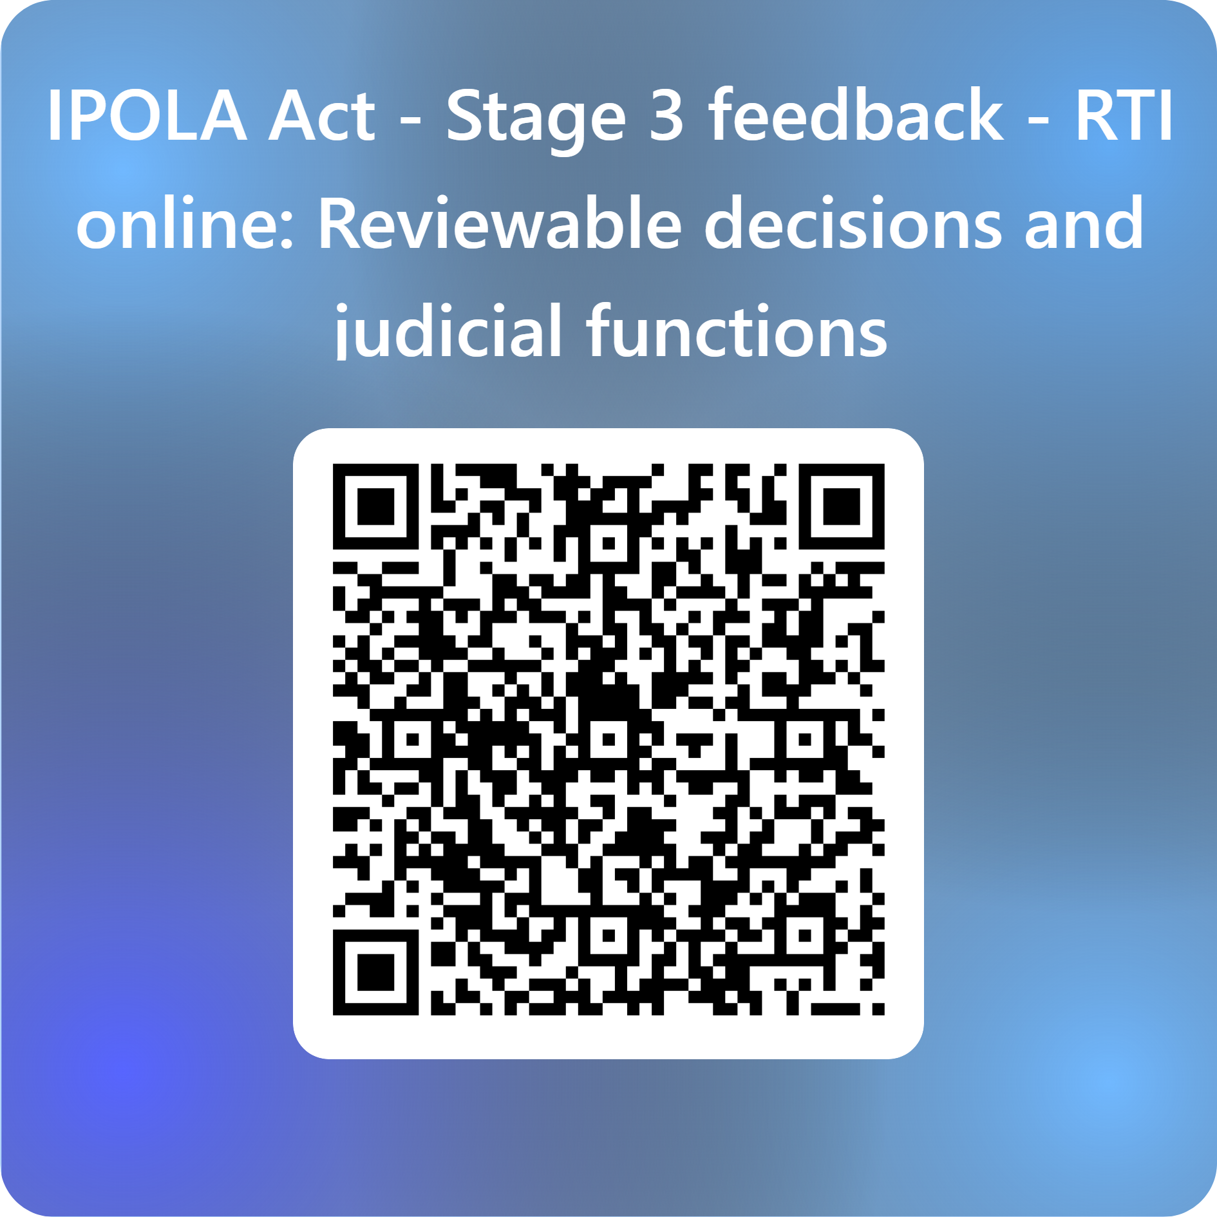
Further information
Ongoing support and advice:
Enquiry Service: 07 3234 737 or 1800 642 753
Email: enquiries@oic.qld.gov.au
Stay connected via LinkedIn or subscribe to our newsletters. Visit OIC.qld.gov.au to subscribe
Feedback:
Link: https://forms.office.com/r/5jEytF2XLF
By QR:
Thank you!

