Slide 1
Information Privacy and Other Legislation Amendment Act 2023 (IPOLA)
Stage 2 – Build Knowledge training
Queensland Privacy Principles
and other privacy reforms

Slide 2
The Office of the Information Commissioner acknowledges the Traditional Owners of country throughout Australia,
and their connection to land and community.
We pay our respects to all Traditional Owners, and Elders
past and present.
Notes:
The Office of the Information Commissioner acknowledges the Traditional Owners of country throughout Australia,
and their connection to land and community.
We pay our respects to all Traditional Owners, and Elders
past and present.

Slide 3
Agenda
Personal information (recap)
The QPPs
Other privacy reforms
Support and information

Slide 4
New Definition: Personal Information
Existing
“…information or an opinion, including information or an opinion forming part of a database, whether true or not, and whether recorded in a material form or not, about an individual whose identity is apparent, or can reasonably be ascertained, from the information or opinion.
New
Personal information means information or an opinion about an identified individual or an individual who is reasonably identifiable from the information or opinion—
(a) whether the information or opinion is true or not; and
(b) whether the information or opinion is recorded in a material form or not.
Notes:
Personal information
I’m showing you the old and new definitions, for comparison.
The broadening of the definition of personal information effects both the RTI Act and the IP Act.
The change moves from a person’s identity being apparent or reasonably ascertained TO an individual who is reasonably identifiable.
The change is subtle, makes it more technology neutral, and brings it into line with Cth Privacy Act.
Despite this, we don’t see a marked difference in the two definitions.

Slide 5
Personal information definition (recap)
The QPPs
Other privacy reforms
Support and information

Slide 6
Queensland Privacy Principles
QPP | QPP Requirement | IPP | NPP
1 | Compliance with QPPs / deal with privacy enquiries / complaints / have a compliant QPP Privacy Policy | 5+ | 5+
2 | Contact anonymously or pseudonymously | -- | 8
3 | Collection and use of personal / personal and sensitive information | 1+, 3 | 2, 9
4 | Assessing / dealing with unsolicited personal information | -- | --
5 | Agency obligation to inform individual about QPP 5.2 | 2 | 1
6 | Primary and secondary purposes information can be used or disclosed | 10, 11 | 2
10 | Agency obligations about use, disclosure, currency, completeness, relevance to the purpose | 3, 8, 9 | 3
11 | Take reasonable steps to protect / destroy / de-identify personal information once no longer required | 4 | 4
12 | An individual can access their personal information | 6 | 6
13 | An individual can correct their personal information | 7 | 7

Slide 7
QPP 1 – Open and transparent management of personal information (IPP 5 expanded / NPP 5 expanded)
Requires the implementation of practices, procedures and systems – to comply with QPPs
Requires clear, up-to-date and accessible QPP Privacy Policy
Prescribes the minimum content of a Privacy Policy
Kinds of/how personal information collected/held
Purposes
Access/correction/complaints
Offshore disclosures
Make available for free on request and accessible in appropriate form
Notes:
QPP 1: Requires agencies to manage personal information in an open and transparent way.
Requires a clear, up-to-date and accessible QPP privacy policy, practices and procedures to ensure QPP compliance.
Implementation practices, procedures and systems – these are ‘things’ the agency does to comply with QPPs
Information management requirements must be stated in a Privacy Policy
Privacy policy – content:
kinds of personal information collects / holds, including sensitive information
how info collected, held, used, disclosed
How individual can access / amend personal information (incl. admin access)
Complaint processes and handling
Overseas disclosures
The privacy policies must be available for free on request and in appropriate form (eg: on website).
NOTE: Health agencies: The new QPP 1 requires the document setting out the “clearly expressed policies for management of personal information” to be a Privacy Policy, and the contents of that policy

Slide 8
QPP 2 – Interacting with an agency anonymously / pseudonymously (IPP New / NPP 8 expanded)
Individuals must have option of not identifying/using pseudonym when dealing with agency
Agency must:
Provide these options and the systems / processes to support them
Unless
Law requires/authorises ID or
Impracticable.
Notes:
QPP 2 Requires agencies to allow individuals the option of not identifying themselves (i.e. to deal with the agency anonymously or pseudonymously) unless it is: • required or authorised under law, or
• impracticable.
We have two guides to aIPOLA Guideline: Anonymity and pseudonymity in complaint management
IPOLA Guideline: - QPP2 – Dealing anonymously with an agency (which includes dealing pseudonymously with an agency)ssist you:
Definitions:
Anonymity
Pseudonymity
Agency must provide these options (how to notify applicants and facilitate applications) and the systems / processes to support the options
Update your agency in Privacy Policy
Exemptions to the requirement:
The law, court / tribunal orders
Where the application relates to an identify document (driver license), payment of benefits, notifiable requirements (diseases, child abuse or certain workplace injuries), provision of personal information
Complaint processes and handling
Overseas disclosures
Impracticality – delivering a request item / service
QPP Policies available for free / on website.
NOTE: for health agencies – this expands the previous requirement of anonymity under NPP 8 to now include the use of a pseudonym.

Slide 9
Scenario 1 - QPP 2
Consider the following situations. Could the individual be anonymous/pseudonymous?
1. Someone wants to make an access application under the RTI Act for their medical records.
2. Someone wants to make a complaint about illegal dumping.
3. Someone calls your agency to ask how much it costs to register a dog.
4. Someone wants to apply for a job.
5. A member of the public wants to make a complaint about an agency staff member they saw drinking beer on the job.
6. An agency staff member wants to make a complaint that another agency staff member bullied them.
Notes:
Answers
No. The RTI Act requires applicants to identify themselves when applying for their personal information; QPP 2.2(a) applies.
Yes. It’s neither unlawful nor impracticable to deal with an anonymous or pseudonymous complainant about a non-personal complaint.
Yes. It’s not unlawful or impracticable to anonymously deal with the individual.
No. It’s impracticable and likely unlawful to deal with an applicant for employment anonymously or pseudonymously; QPP 2.2 applies.
Yes. It’s neither unlawful nor impracticable to deal with an anonymous or pseudonymous complainant for a non-personal complaint.
No. Due to the personal nature of the complaint, it would be impracticable to deal with the complainant anonymously or pseudonymously; QPP 2.2(b) applies.

Slide 10
QPP 3 Collection of solicited personal information (IPP 1 expanded, IPP 3 / NPPs 1 and 9)
Personal information generally
Must not collect personal information unless reasonably necessary for, or directly related to, 1 or more functions or activities
Must only collect
By lawful/fair means, and
From the individual – unless
Consent
Required/authorised under law or
Unreasonable/impracticable
Notes:
QPP 3 Provides that agencies:
• can only collect personal information that is reasonably necessary for, or directly related to, one of their functions or activities
• must collect it lawfully and fairly, and
• must collect it from the individual unless an exemption applies (including consent, lawful authority or requirement, and law enforcement), or it is unreasonable or impracticable to do so.
Higher standards apply to the collection of sensitive information. For example, an agency is required to implement higher standards of verification about the accuracy and quality of collection processes when sensitive information is collected and shared by a third party.
Personal information is only collected if the agency solicits it, i.e., they ask someone for it or otherwise takes active steps to acquire it.
Unsolicited personal information sent to an agency is not collected and must be assessed under QPP 4. (Coming up)
Under QPP 3:
Collection Notice – Must be voluntary:
Sensitive information – by consent (unless exempt)
Other information – express or implied
Expanded definition of sensitive information, now includes:
health information
genetic information that is not otherwise health information
biometric information used for automated biometric verification or biometric identification (eg: mobile phone finger-print or facial scans)
biometric templates.
Ways of collecting: Must be from the individual (subject to exemptions)
Relevance to function: Requirement that collected information directly maps to agency function
No ‘just in case’ collections.
NOTE: Health agencies –
NPP 1 is expanded to include sensitive information (was NPP 9)
No specific change to the requirements in NPP 2 – but that these requirements now appear in QPP 3
NPP 9 obligations for collecting and handling sensitive information now appear in QPP 3.
Secondary purpose exemptions to the use or disclosure of health-related personal information are in QPP 6

Slide 11
QPP 3 Collection of solicited personal information (IPP New, NPPs 1 and 9)
Sensitive information
Must not collect sensitive information unless reasonably necessary for, or directly related to, 1 or more functions or activities
and
With consent – unless
Required/authorised under law
‘Permitted General’ or ‘Permitted Health’ situation
Law enforcement agency and reasonably believe collection reasonably necessary
Notes:
QPP 3 Provides that agencies:
• can only collect personal information that is reasonably necessary for, or directly related to, one of their functions or activities
• must collect it lawfully and fairly, and
• must collect it from the individual unless an exemption applies (including consent, lawful authority or requirement, and law enforcement), or it is unreasonable or impracticable to do so.
Higher standards apply to the collection of sensitive information. For example, an agency is required to implement higher standards of verification about the accuracy and quality of collection processes when sensitive information is collected and shared by a third party.
Personal information is only collected if the agency solicits it, i.e., they ask someone for it or otherwise takes active steps to acquire it.
Unsolicited personal information sent to an agency is not collected and must be assessed under QPP 4. (Coming up)
Under QPP 3:
Collection Notice – Must be voluntary:
Sensitive information – by consent (unless exempt)
Other information – express or implied
Expanded definition of sensitive information, now includes:
health information
genetic information that is not otherwise health information
biometric information used for automated biometric verification or biometric identification (eg: mobile phone finger-print or facial scans)
biometric templates.
Ways of collecting: Must be from the individual (subject to exemptions)
Relevance to function: Requirement that collected information directly maps to agency function
No ‘just in case’ collections.
NOTE: Health agencies –
NPP 1 is expanded to include sensitive information (was NPP 9)
No specific change to the requirements in NPP 2 – but that these requirements now appear in QPP 3
NPP 9 obligations for collecting and handling sensitive information now appear in QPP 3.
Secondary purpose exemptions to the use or disclosure of health-related personal information are in QPP 6

Slide 12
Definition of ‘sensitive information’
(a) information or an opinion, that is also personal information, about the individual’s:
(i) racial or ethnic origin
(ii) political opinions
(iii) membership of a political association
(iv) religious beliefs or affiliations
(v) philosophical beliefs
(vi) membership of a professional or trade association
(vii) membership of a trade union
(viii) sexual orientation or practices
(ix) criminal record
(b) health information about the individual;
(c) genetic information about the individual that is not otherwise health information;
(d) biometric information that is to be used for the purpose of automated biometric verification or biometric identification; or
(e) biometric templates.
Notes:
Sensitive information is a category of personal information and is defined in the IP Act Dictionary, Schedule 5.
Under QPP 3.3, agencies can only collect sensitive information where the collection is reasonably necessary for, or directly related to, functions or activities of the agency, and the individual consents;
However, consent is not required when (QPP 3.4):
the collection is required or authorised by law or court order
the agency is a law enforcement agency and collection is for one or more of its functions or activities
the agency is a health agency, and a permitted health situation exists in relation to the collection of the information; or
a permitted general situation exists in relation to the collection of the information by the agency.
The permitted general situations are those that allow agencies to use or disclose personal information for a secondary purpose under QPP 6.2(c). I won’t go through them in detail, but they will be included in the Stage 2 and 3 training.
We have published a useful Guide about personal and sensitive information to help you understand the definitions and to prepare for the IPOLA changes. [click the link].
Now, returning to the QPPs – here is list of the QPPs and comparison to the IPPs and NPPs.

Slide 13
Scenario 2 - QPP 3
Apply QPP 3 to these scenarios
1. Your agency advertises several legal officer positions. The person running the recruitment process wants to require all applicants to provide proof they have a law degree and can practice as a lawyer in Queensland.
2. As part of an agency recruitment process, the candidate nominates their former boss as a referee. The agency intends to obtain a written reference directly from the referee.
3. As part of managing a problematic agency employee, the chief executive of the agency requires the employee to undergo a mental health assessment in accordance with the Public Sector Act, which gives the chief executive this power. The assessment is to be forwarded from the assessing practitioner to the chief executive.
Notes:
Collection of evidence that job applicants are appropriately qualified for the position being advertised is reasonably necessary for an agency’s functions and satisfies QPP 3.1.
2. Ensuring candidates for a position are suitable is reasonably necessary for an agency’s functions and satisfies QPP 3.1, and asking for a reference is part of establishing suitability. A reference is personal information about the candidate collected from someone else, but this can be done with the individual’s consent under QPP 3.6(a)(i), which can be implied from the candidate nominating their former boss as a referee.
3. Information about an employee’s mental health is sensitive information, which will be collected from someone else (the doctor doing the assessment). 3.4(a) allows sensitive information to be collected without consent where it’s authorised or required by law, and 3.6(a)(ii) allows it to be collected from someone else where it’s authorised or required by law.

Slide 14
QPP 4: Dealing with unsolicited personal information
Unsolicited:
Personal information received by an agency that the agency took no active steps to collect; that someone has given or sent to an agency at their own instigation.
Agency must, within a reasonable period, decide whether could have collected under QPP 3
Deal with according to QPPs 5 to 13
If not a public record, and lawful and reasonable:
Destroy or de-identify as soon as practicable
Yes?
No?
Notes:
Definition:
Personal information received by an agency that the agency took no active steps to collect that someone has given or sent to an agency at their own instigation (eg: a petition, an agency form completed with more information than was asked for)
Requires agencies to assess unsolicited personal information to determine whether they could have collected it under QPP 3 and/or whether it is a public record. If not, agencies may be required to destroy or de-identify unsolicited personal information, subject to public record laws. Otherwise, QPPs 5 to 13 apply.
NOTE: For health agencies – how to deal with unsolicited personal information was not in the NPPs. However, general guidance was provided in the OIC’s Basic guide to NPP 1.
How to deal with unsolicited personal information (including health-related personal information) is now formalised in QPP 4.

Slide 15
Scenario 3 - QPP 4
For the purposes of these scenarios assume nothing is a public record (even if you know it would be a public record in real life) and that destruction/deidentification would not be unlawful.
You work for the Cats and Dogs agency. Apply QPP 4 to these scenarios:
1. Your agency receives an email from a Johnny Johnson about their extensive grievances against the Australian court system, which they claim is corrupt and prejudiced against people named Johnny. They have included a list of other people named Johnny who’ve been harmed by this prejudice. It was sent to the High Court and CC’d to 167 agencies, including yours. Your agency is responsible for administering pastry-making, not courts.
2. Your agency releases a discussion paper about whether cats should all be reclassified as dogs. In response, you receive a submission from Janet Franks. Inextricably mixed in with her otherwise relevant submission is information about her childhood, her parents, her siblings, and their rocky relationship.
3. Your agency receives an email advising that Ben Couris is breeding cats and dogs in their backyard at 18 Isaac Lane without a permit from your agency, which is a breach of the Cats and Dogs Act.
Notes:
The personal information in the email does not relate to, and is not necessary for, your agency’s functions or activities, as required by QPP 3.1. It is not a public record, nor is it unlawful or unreasonable to destroy it by deleting the email.
2. Responses to the discussion paper were solicited, but personal information about Janet, her parents, her siblings, and their relationship was not. The unrelated personal information does not relate to, and is not necessary for, your agency’s functions or activities. The submission is not a public record, and it would not be unlawful to destroy or deidentify it. However, it would be unreasonable to destroy or deidentify it, because the unrelated personal information is inextricably mixed in with Janet’s response to the submission, which means QPPs 5-13 apply as if the agency had collected it under QPP 3.
3. Personal information about someone allegedly in breach of the legislation you administer is reasonably necessary for and directly related to your agency’s functions, which satisfies QPP 3.1. QPPs 5-13 apply to the information as if the agency had solicited it under QPP 3.

Slide 16
QPP 5: Notification (IPP 2 / NPP 1)
When?
At or before – or as soon as practicable after – collection
Range of matters listed in QPP 5.2, including:
If collected from a 3rd party/individual may not be aware: facts/circumstances of collection
Main consequences, if any, if the personal information is not collected
Flexible approach with no mandatory template. Consider:
Brief notices on forms about the specific information collected
Webpages and/or brochures that provide an expanded notice containing the QPP 5 matters
Links to agency QPP 1 privacy policy
QPP 5.1 – reasonableness test
May be reasonable not to provide notice, or ‘full’ notice, in some circumstances.
What?
How?
Always?
Notes:
Reasonable steps requirement not absolute – there may be some circumstances where there are no reasonable steps an agency can take or no reasonable steps it needs to take. For example, the person is already aware the information is being collected, where notification poses a serious risk to the person (eg: a police informant), notification could jeopardise the purpose of the collection (eg: covert surveillance on a criminal suspect), notification could pose a risk to others (eg: a DV application), or practicality – time and cost outweighs the privacy benefit (eg: emergency situation

Slide 17
QPP 6 Use and disclosure (IPP 10 & 11 / NPP 2)
Starting point:
Only use/disclose for primary purpose information was collected
Unless….
Consent to secondary purpose
Reasonable expectation – related/directly related (sensitive) to the primary purpose
Required/authorised under a law
Permitted general or permitted health situation
Reasonable belief reasonably necessary for enforcement body enforcement activities (written note)
ASIO
Research
Notes:
Written note for law enforcement use/disclosures
Health agencies must deidentify

Slide 18
Scenario 4 - QPP 6
For the purposes of these scenarios, assume that no legislative confidentiality requirements apply to the information.
Identify which part of QPP 6 applies to the use or disclosure of personal information in these scenarios:
1. The local Council sets up surveillance to identify people illegally dumping rubbish in a local park. They capture footage of several people and want to prosecute them.
2. QPS receives a tip through its website that Mary Jane, a teacher, is selling marijuana to students. QPS wants to use/disclose this personal information to investigate.
3. A former employee is suing your agency for emotional distress arising out of their employment. Can you give their personnel and other employee records to your agency’s lawyers? (Slide 23)
Notes:
Answers
Council collected this personal information for the purposes of enforcing illegal dumping laws. Using or disclosing it to enforce illegal dumping laws is a use or disclosure for the primary purpose of collection.
Selling marijuana is against the law in Queensland. QPS can use or disclose Mary Jane’s personal information under QPP 6.2(e), because it is reasonably necessary for one or more enforcement-related activities conducted by a law enforcement agency.
Yes. Under QPP 6.2(c), personal information can be used or disclosed for the permitted general situations in schedule 4. Schedule 4, part 1, section 1(d) allows an agency to use or disclose personal information which is reasonably necessary for the establishment, exercise or defence of a legal or equitable claim.

Slide 19
QPP 10 Quality of personal information (IPP 3, 8 & 9 / NPP 3)
Agencies must take reasonable steps to ensure the quality of personal information:
At collection, use, or disclosure – the information is accurate, up to date, complete
For use or disclosure, is relevant to the purpose of the use or disclosure.
Reasonable steps, depends on circumstances:
Reliability of the source
Recency of collection
Level of sensitivity of information
sensitive information requires more rigor at point of collection
Collection from a 3rd party
ensure 3rd party has established strong and reliable collection and use practices, noting more rigor required for sensitive information.
Notes:
Requires agencies to take reasonable steps to ensure the personal information:
• they collect, use, or disclose is accurate, up to date, complete, and
• for use or disclosure, is relevant to the purpose of the use or disclosure.
NOTE: For health agencies – the general requirement in NPP 3 to take reasonable steps to ensure that the personal information it collects, uses or discloses is accurate, complete and up to date, is now proscriptive about what would comprise reasonable steps.

Slide 20
QPP 11 Security of personal information (IPP 4 / NPP 4)
Agencies to take reasonable steps to protect personal information from
misuse, interference, loss
unauthorised access, modification, disclosure
Where agency no longer needs personal information for any purpose for which the information may be used or disclosed under the QPPs, agency must take reasonable steps to destroy the information or ensure that it is de-identified.
Unless:
the personal information is part of a public record, or
required by law or a court/tribunal order to retain the personal information
Notes:
REASONABLE STEPS: SENSITIVITY

Slide 21
Scenario 5 – QPP 11
Your agency is setting up a new database to manage customer interactions. It will be used by every business unit in the agency, many of whom have different, unrelated functions.
What are some steps your agency could take to ensure the database is QPP 11.1 compliant?
2. Your agency has let old paper files pile up in off-site storage over the past ten years. What do you need to do to comply with QPP 11.2?
Notes:
Answers
Reasonable steps could include:
Implement logging and monitoring, so access can be audited and unauthorised access detected.
Use permission-based access, so that each business unit only has access to their clients’ information.
Prepare written polices or procedures that set out the acceptable uses of the database and the consequences of misusing it.
Set strong password protocols and ensure users are trained on not sharing passwords.
Give users of the database appropriate training in privacy and information security, as well as how to use the database.
Appropriately encrypt the data in the database.
Ensure the database is appropriately backed up, to prevent loss of personal information in the event of a technological failure.
2. There are several steps that should be taken:
Assess whether the files contain personal information. If they don’t, QPP 11 doesn’t apply.
Identify which of the files are public records. QPP 11.2 does not apply to public records, so anything which is a public record does not need to be assessed any further.
However, if the files are old they should be assessed under the relevant Retention and Disposal schedule. If they’re eligible for disposal, a reasonable step under QPP 11.1 to protect the personal information in the public records would include making sure they’re appropriately destroyed.
For any files that aren’t public records, assess whether the agency still needs the personal information, based on the uses and disclosures permitted by QPP 6. Given the files have been sitting in storage for a decade, chances are good that the agency doesn’t need them anymore.
Check whether there’s a law or court or tribunal order that requires your agency to keep them.
If not, identify if it’s reasonable to destroy or deidentify the files. Given these are paper files, having them securely shredded would be an appropriate way to dispose of them.

Slide 22
QPP 12 Access to personal information (IPP 6 / NPP 6) QPP 13 Correct personal information (IPP 7 / NPP 7)
QPP 12:
Administrative, or via RTI access application
QPP 13:
Administrative, or via RTI amendment application
Notes:
Bound contracted service providers (bound under section 35 of the IP Act) are not subject to the RTI Act but are subject to the QPPs.3 Agencies should ensure there are processes in place for individuals to access and correct their personal information held by bound contracted service providers. This could be done by, for example: • ensuring contracted service providers understand their access and correction obligations under QPP 12 and 13 and providing guidance; or • by establishing in the contract that relevant documents remain under the control of the agency, which means individuals can apply to the agency for access to or correction of their information.

Slide 23
Permitted General Situations (Sch 4 Pt 1) Collection, use disclosure
Necessary for lessening or preventing a serious threat to life, health or safety, and unreasonable or impracticable to obtain individual’s consent
Agency has reason to suspect that unlawful activity, or misconduct of a serious nature, relates to the agency’s functions or activities has been, is being or may be engaged in, and the agency reasonably believes that the collection, use or disclosure is necessary for the agency to take appropriate action in relation to the matter.
Locating a missing person (requires OIC guideline to ‘activate’)
Establishing, exercising or defending a legal or equitable claim
Confidential alternative dispute resolution process.
Notes:
Exemptions provided under QPP 3.4:
Includes Permitted General Situations:
Necessary for lessening or preventing a serious threat to the life, health or safety, and unreasonable or impracticable to obtain individual’s consent
Agency has reason to suspect that unlawful activity, or misconduct of a serious nature, relates to the agency’s functions or activities has been, is being or may be engaged in, and the agency reasonably believes that the collection, use or disclosure is necessary for the agency to take appropriate action in relation to the matter.
Locating a missing person (collection, use, disclosure complies with a guideline in effect under chapter 3, part 2)
Establishing, exercising or defending a legal or equitable claim
Confidential alternative dispute resolution process.

Slide 24
Permitted Health Situation (Sch 4 Pt 2)
Collection (QPP 3 -health information)
Provision of a health service – authorised or required by law/reasonably expect
Family/social medical history, including from ‘responsible person’
Research
Use or disclosure (QPP 6)
Research – impracticable to obtain consent, in accordance with chief exec guidelines
To responsible person for an individual/consent impossible/necessary for care/compassion/not contrary to prior wishes/limited to extent reasonable and necessary

Slide 25
Agenda
Personal information definition (recap)
The QPPs
Other privacy reforms
Support and information

Slide 26
Other Changes to the IP Act
Mandatory Notification of Data Breach (MNDB) scheme
A separate training session
Commissioner Enhanced Powers
Own motion investigations
Privacy complaints

Slide 27
Privacy complaints
Complaints may be made about:
Privacy principle requirements
MNDB compliance
Requirements (New s.166A)
In writing, with an address & particulars
Within 12 months of becoming aware (longer with agency agreement)
Agencies obliged to provide reasonable help to complainant to frame in writing
Response (New s.164A)
45 business days to deal with complaint
may request further time
Pathway to OIC
Complainant either dissatisfied with outcome
45 business days passes without outcome

Slide 28
Personal information definition (recap)
The QPPs
Other privacy reforms
Support and information

Slide 29
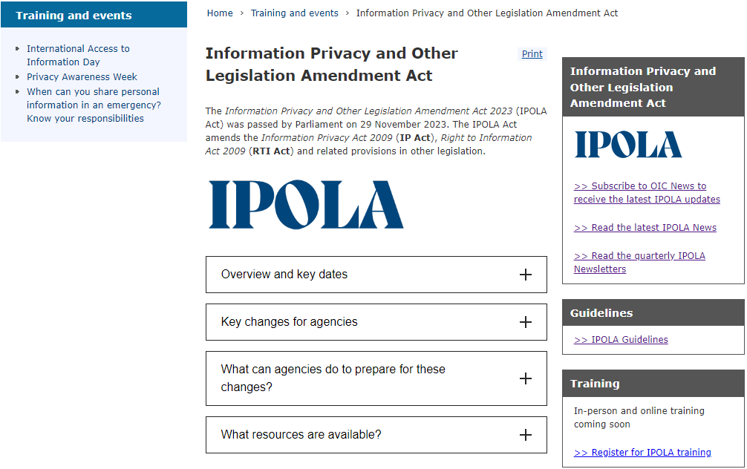
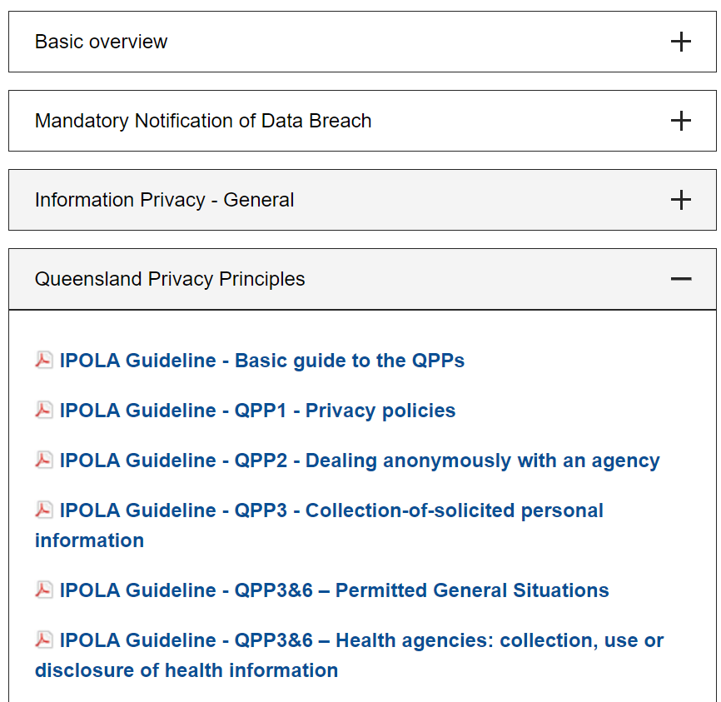
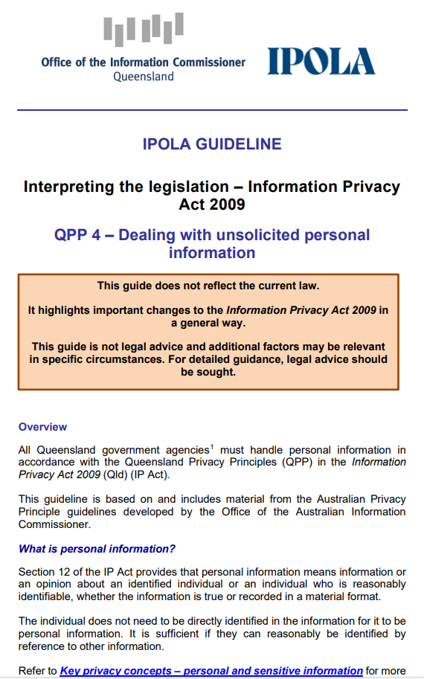
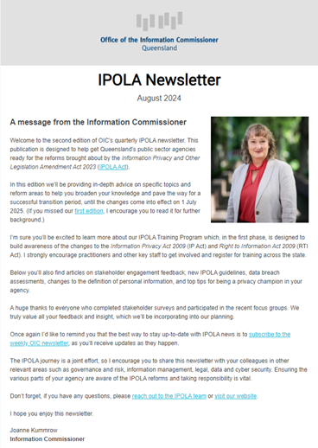
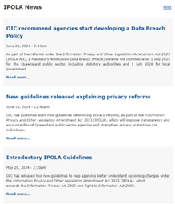
IPOLA webpage
Guidelines
Newsletters

Slide 30
We are available to answer questions and provide advice
Email: IPOLA.Project@oic.qld.gov.au
Enquiry Service: 07 3234 7373
Notes:
The Information Commissioner will provide guidance and training between now and the commencement of the scheme.
Other avenues of information include:
Contacting the OIC Enquiry Service;
Subscribing to OIC news; and
Accessing specific OIC guidelines as they are published on the OIC Website.

